Slide 1
POMODORA TIMER 番茄時鐘
財金系 唐榕岑 408537321

Slide 2
Motive
不想花錢買現成品
做自己常用的東西
自己喜歡的設計

Slide 3
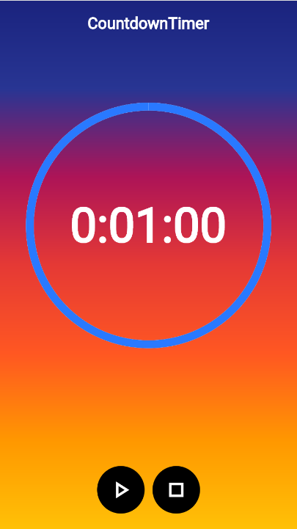
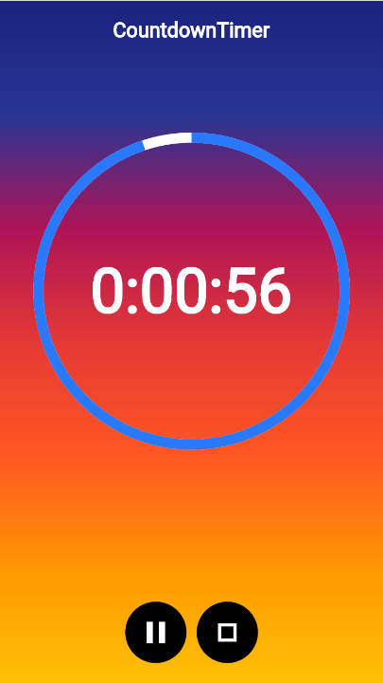
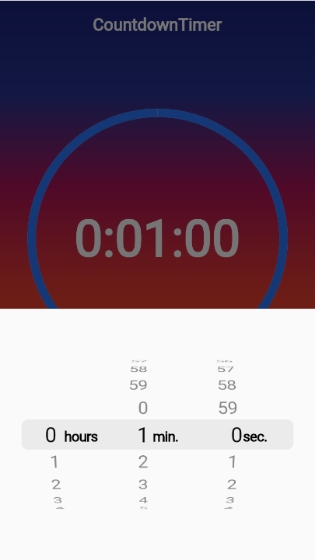
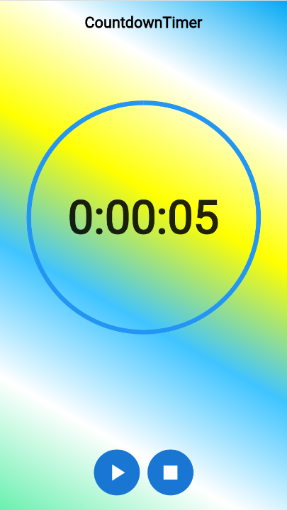
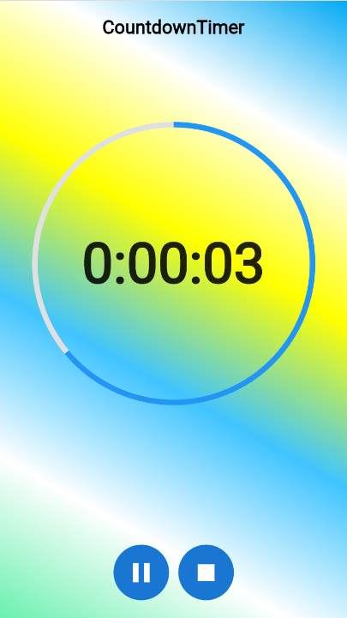
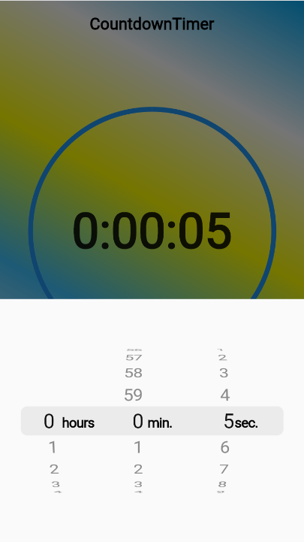
Function
Transparent App bar
Gradient Background
Start Button
Restart Button
Stop Button
Time Picker

Slide 4
Problem
原本想要把倒數圓圈替換成其他圖案，無奈功力太差做不出來

Slide 5
Reference
Countdown timer:
https://www.youtube.com/watch?v=bjAsnIw3VCs
Creating a Countdown Timer using Animation in Flutter | by Ashish Rawat | FlutterDevs
Time picker:
https://www.youtube.com/watch?v=gQFRwAvShJc
Background:
https://www.youtube.com/watch?v=eN62zlmjAEQ&t=0s

